Slide 1




DATA STRUCTURES & ALGORITHM PROJECT
FLIGHT MANAGEMENT SYSTEM
Alishba Haider FA22-BAI-013
Alisba Ali FA22-BAI-006
Muhammad Amaan FA22-BAI-055

Slide 2

OUTLINES
INTRODUCTION
FEATURES
USER INTERFACE
WORKING
DATA STRUCTURES VISUAL REPRESENTATION
ALGORITHM

Slide 3
INTRODUCTION
The "Airline Management System" is a dedicated Data Structures and Algorithms (DSA) project that introduces a simplified Graphical User Interface (GUI) for efficient flight reservations. With a clear interface, users are presented with primary options, including an 'About' section detailing flight schedules and a 'Passenger' section for bookings. This system integrates fundamental DSA concepts with object oriented programming to offer a streamlined booking experience, prioritizing user-friendliness and functionality.
FEATURES
User can:
create and manage their account.
view the flights schedule.
book their flights.
select between economy & business class seats.
view their bill.
cancel their flights if needed.

Slide 4
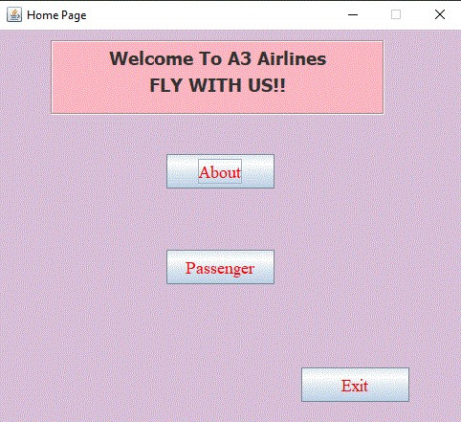
USER INTERFACE
HOME PAGE:

Slide 5
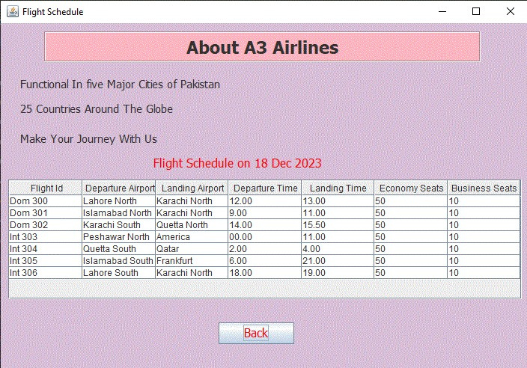
USER INTERFACE
ABOUT:

Slide 6
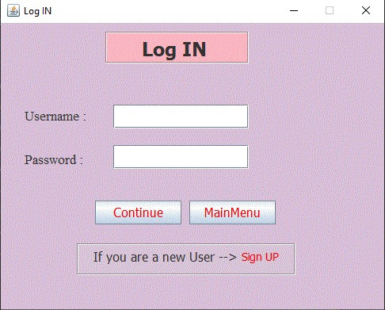
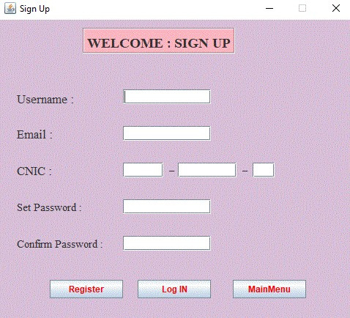
USER INTERFACE
LOGIN/SIGNUP:

Slide 7
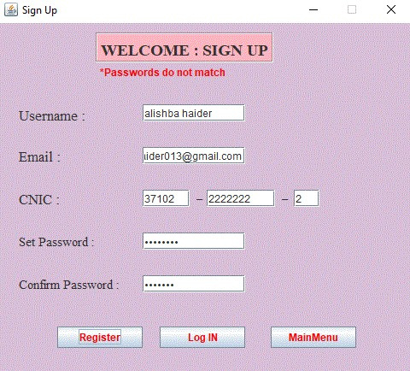
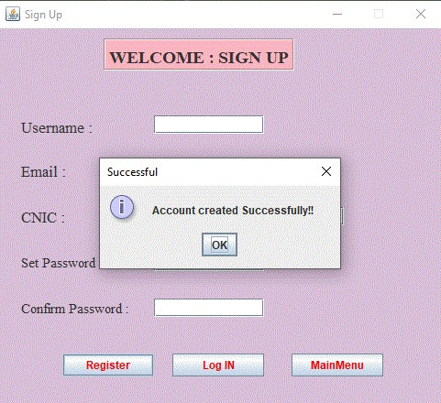
USER INTERFACE

Slide 8
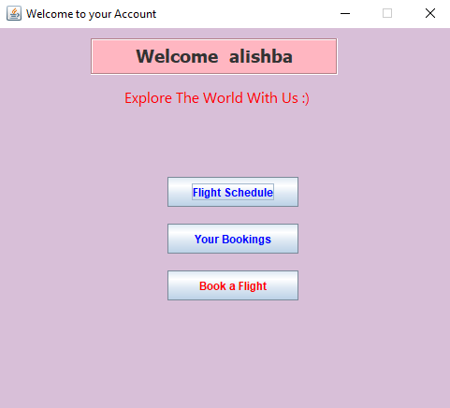
USER INTERFACE
USER ACCOUNT:

Slide 9
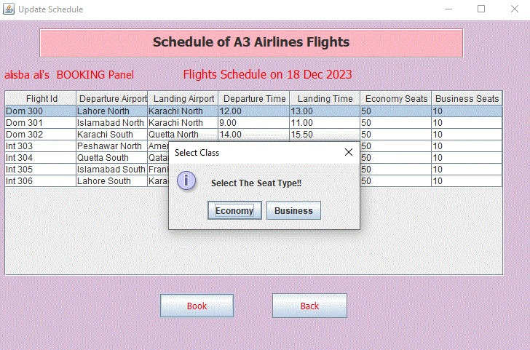
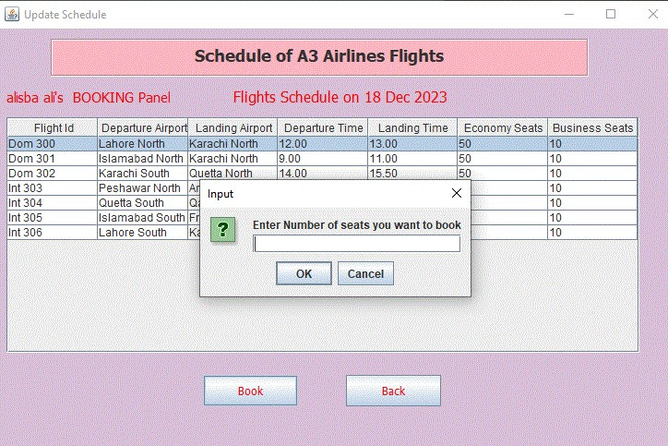
USER INTERFACE
FLIGHT BOOKING:

Slide 10
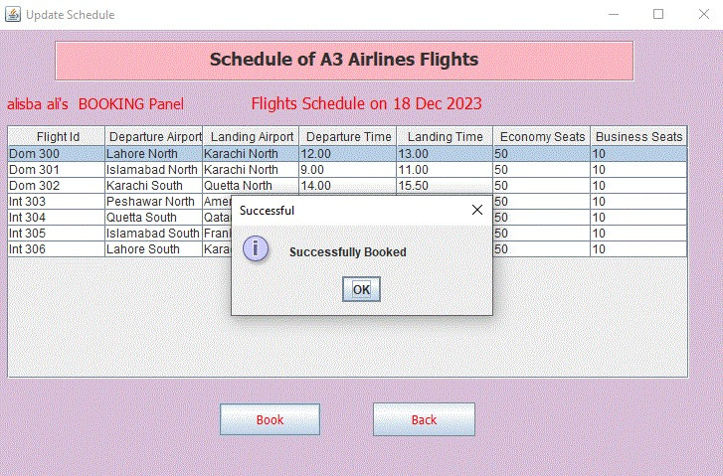
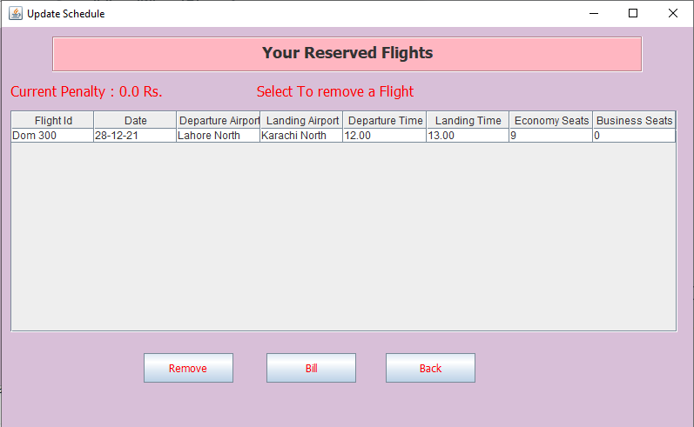
USER INTERFACE

Slide 11
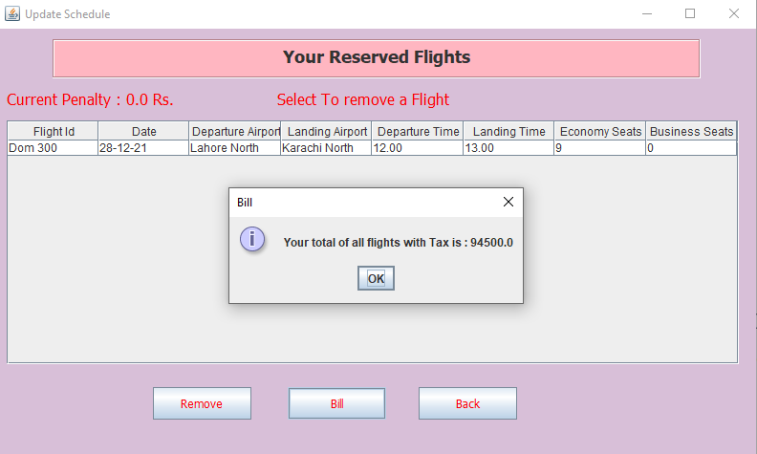
USER INTERFACE
BILL:

Slide 12
WORKING
WORKING
START
SIGN UP
BOOK FLIGHT
PASSENGER
BOOKINGS
LOG IN
ABOUT
FLIGHT SCHEDULE
END

Slide 13
PASSENGERS LINKED-LIST
passenger obj node
USERNAME
PASSWORD
EMAIL
CNIC
P
P
P1
P2
P3
NULL
alishba
Amaan
alisba
Alishba1.
amaanawan25
@gmail.com
Alisba.123
a@gmail.com
lis@gmail.com
12..-22-..6
12..-22-..2
12..-22-..3

Slide 14
FLIGHTS LINKED-LIST
flights obj node
FLIGHT ID
DEPARTURE TIME, AIRPORT
LANDING TIME, AIRPORT
ECONOMY SEATS, BUSINESS SEATS
F
F
F1
F2
F3
DOM 304
12:00 ; Karachi
01:30 ; Lahore
100 ; 30
DOM 305
01:00 ; Karachi
02:00 ; Islamabad
110 ; 30
INT 301
12:00 ; Islamabad
03:00 ; Doha
100 ; 35

Slide 15
BOOKINGS LINKED-LIST
DEPARTURE TIME, AIRPORT
LANDING TIME, AIRPORT
FLIGHT ID
ECONOMY SEATS, BUSINESS SEATS
DATE
bookings obj node
B
B
B1
B2
B3
12:00 ; Karachi
01:30 ; Lahore
DOM 304
100 ; 30
21 Dec 2023
01:00 ; Karachi
02:00 ; Islamabad
DOM 304
110 ; 30
21 Dec 2023
12:00 ; Doha
03:00 ; Islamabad
DOM 304
100 ; 35
21 Dec 2023

Slide 16
ALGORITHM FOR INSERTING INTO LISTPASSENGER
Define a Passenger class with attributes username, email, cnic, password.
Take these attributes from graphical user interface.
if all the checks are valid then
Create a new Passenger object using the provided parameters.
Traverses the listPassenger:
If the cnic already exists in the listPassenger, update the existing entry.
If the cnic doesn't exist, add the new Passenger object to the listPassenger.

Slide 17
ALGORITHM FOR INSERTING INTO LISTPASSENGER
Define a Flights class with relevant attributes
Flight id
Departure time, Airport
landing time, airport
economy seats, business seat
2. Take these attributes as parameters and create flight object.
Create a Flights object.
Traverses the listFlights:
If the flight ID already exists in the listFlights, update the existing entry.
If the flight ID doesn't exist, add the provided Flights object to the listFlights

Slide 18
ALGORITHM FOR INSERTING INTO LISTFLIGHTS
Define a BookingObject class with attributes same as flight class.
Create a BookingObject object and pass the attributes of booked flight by user.
Traverses the listBookings:
If the booking ID already exists in the listBookings, update the existing entry.
If the booking ID doesn't exist, insert the provided BookingObject into the listBookings.

Slide 19
ALGORITHM FOR PASSWORD VALIDATION
FUNCTION validPassword(str)
# Convert password string to character array
array ← str.toCharArray()
# Initialize boolean flags to track character types
capital ← false
small ← false
digit ← false
special ← false
# Check for capital letters
FOR each character IN array
IF Character.isUpperCase(character)
capital ← true
BREAK END FOR

Slide 20
ALGORITHM FOR PASSWORD VALIDATION
# Check for lowercase letters
FOR each character IN array
IF Character.isLowerCase(character)
small ← true
BREAK END FOR
# Check for digits
FOR each character IN array
IF Character.isDigit(character)
digit ← true
BREAK END FOR
# Check for special characters
FOR each character IN array
IF NOT Character.isDigit(character) AND NOT Character.isLetter(character) AND NOT Character.isWhitespace(character)
special ← true
BREAK END FOR
# Return true only if all criteria are met RETURN capital AND small AND digit AND special END FUNCTION

Slide 21

FOR YOUR PATIENCE

